Slide 1
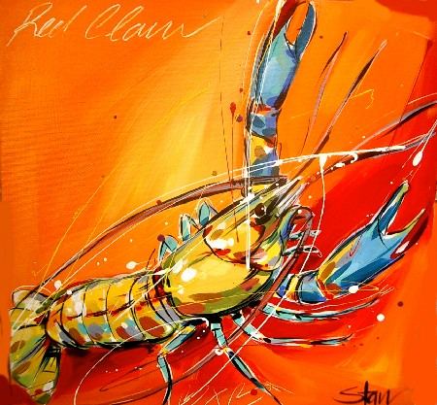
Redclaw Crayfish Hatchery
Development of mass production hatchery technology for Cherax quadricarinatus
Clive Jones, Colin Valverde and Damian Rigg
Notes:
This is an alternative title page with space for images.

Slide 2
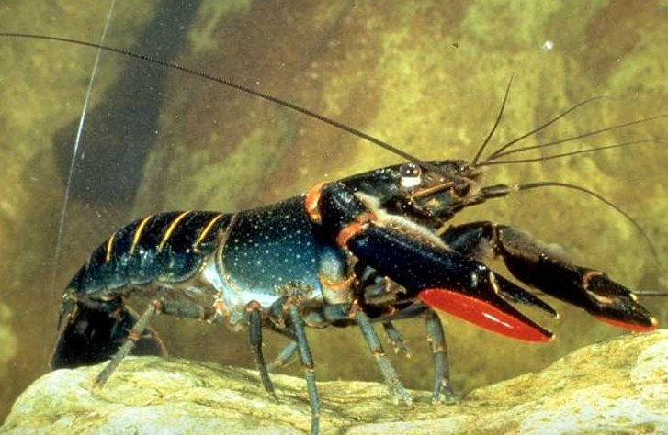
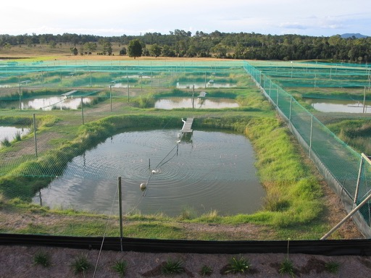
Redclaw industry
Initiated in Queensland, late 1980’s
Translocated worldwide
Same story everywhere – poor production
In Queensland, around 100 tonnes production per year for past 20 years
Most critical issue is seed supply
On-farm juvenile production is slow, occupies valuable space and is low in productivity
Notes:
Slide for body text

Slide 3
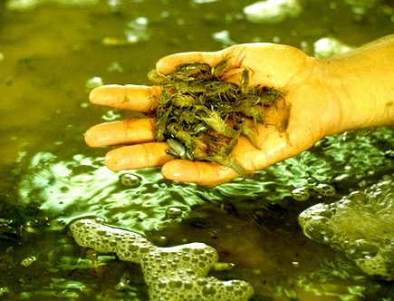
Seed supply
All successful commercial aquaculture has a reliable, cost effective, year-round supply of seed
Redclaw has simple reproduction – no free-living larval stage, hatching of viable juveniles
Farmers have readily harnessed this to produce their own juveniles for stocking to growout
But it’s very inefficient
Notes:
Slide for body text

Slide 4
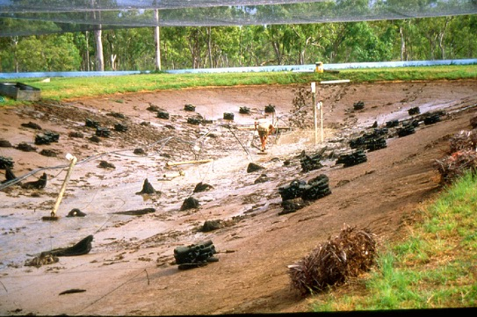
Juvenile production
Traditional (1,000 m² earthen pond)
Broodstock stocked at 250F : 100M
80 to 100 advanced juveniles per female
20 to 25,000 juveniles produced per pond
Crop every 4 months
250 shelters per pond
Managed plankton production for food
Harvest by flowtrap
Notes:
Slide for body text

Slide 5
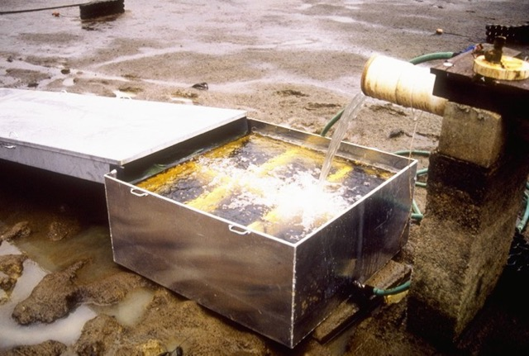
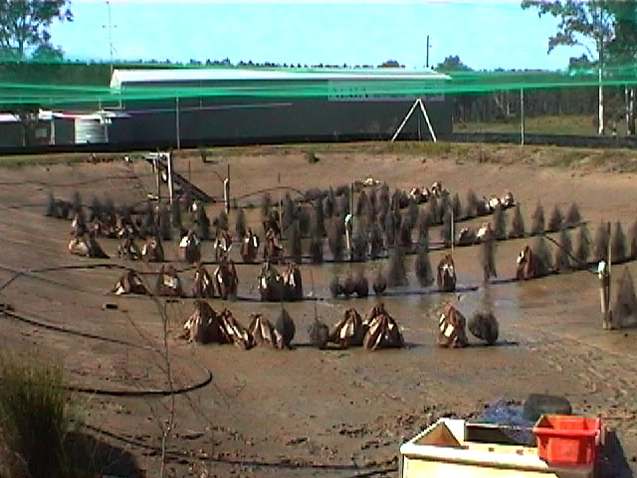
Juvenile production
Newly hatched too delicate for harvest
3 to 4 months to generate 5-10g juveniles
Then suitable for harvest by flow trap
Stocked to ponds for grow out
Notes:
Slide for body text

Slide 6
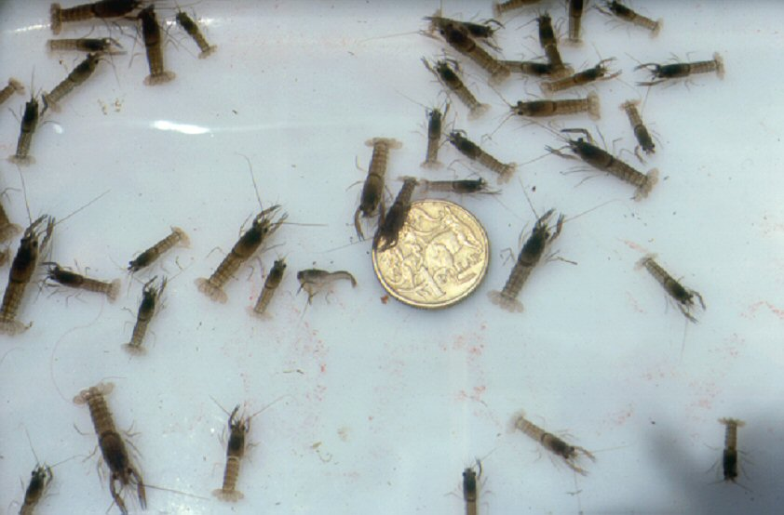
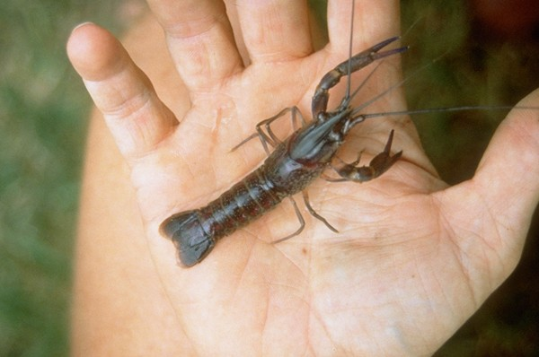
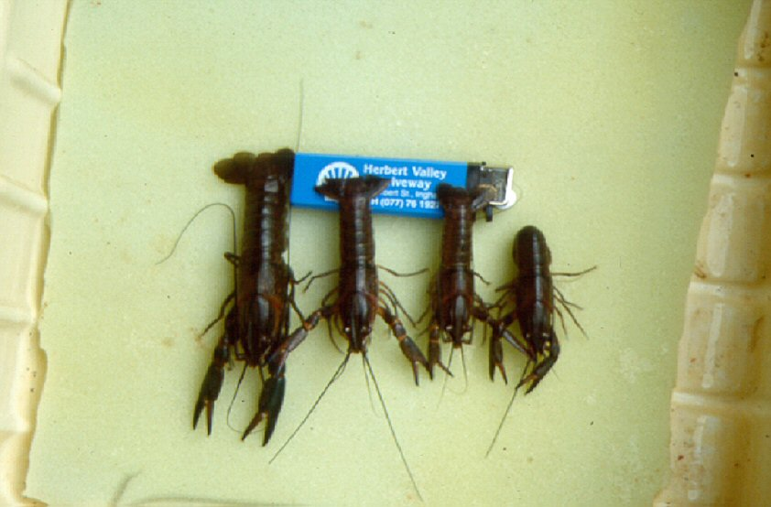
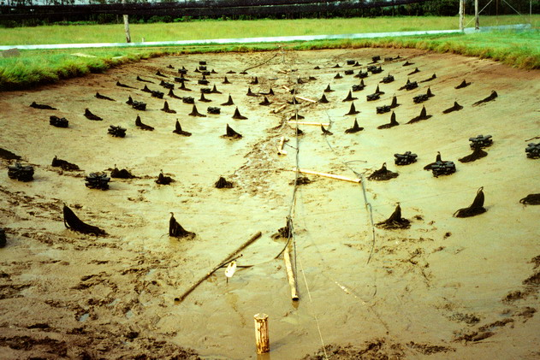
Traditional juvenile production
Notes:
Slide for body text

Slide 7
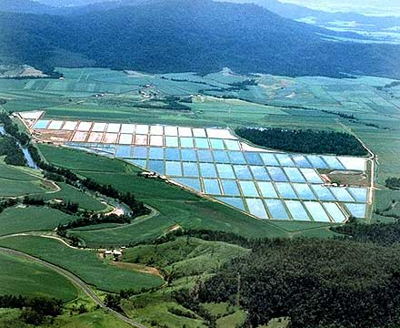
Traditional growout stocking
Stocking density, 5-10/m²
10,000 per 1,000m² pond
One juvenile pond at 3 crops per year can produce 75,000 juveniles
Sufficient for 7 growout ponds per year
14% of ponds dedicated to juvenile production – generating no income
Notes:
Slide for body text

Slide 8
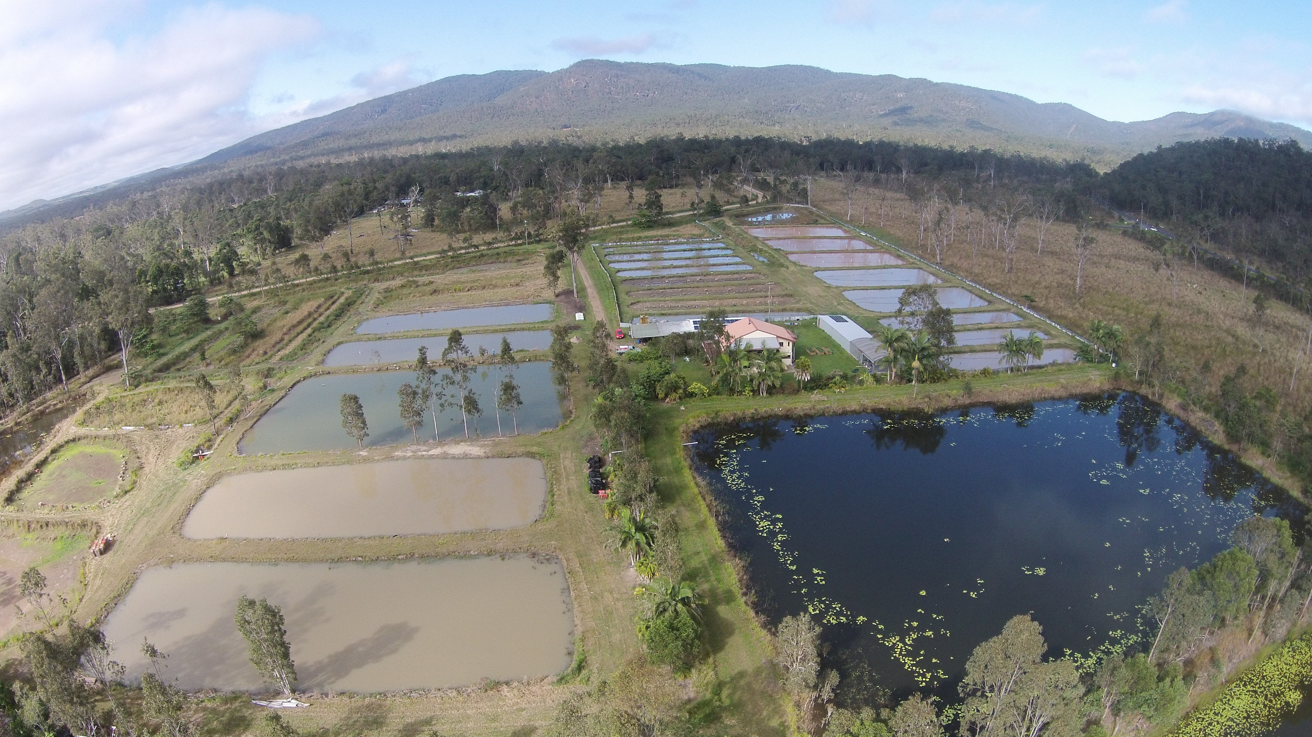
Alternative approach
Redclaw farmer Colin Valverde - Aquaverde
Located in north-east Australia
Ideal, tropical location for redclaw
Constrained by supply of juveniles
Is there a better way?
Notes:
Slide for body text

Slide 9
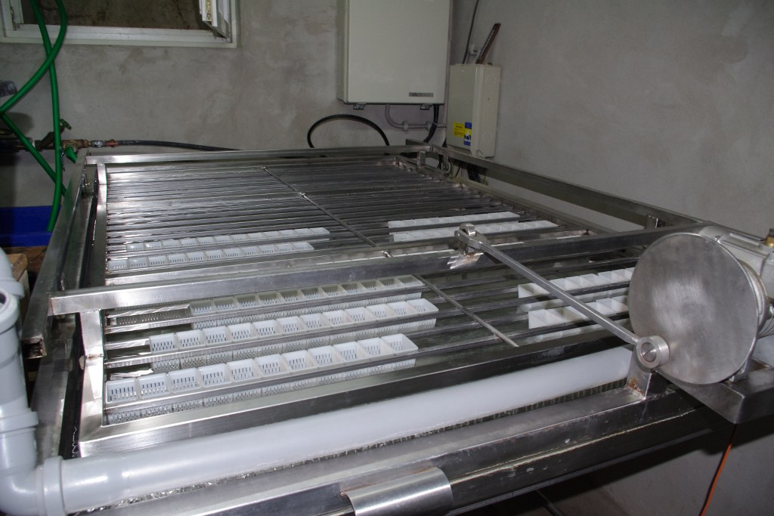
Initial consideration
1996 Dr Brett Edgerton (crayfish pathologist) assessed the Finnish ‘Hemputin’ to rear eggs independently of the mother
Hemputin – artificial incubation system from Finland
Purpose to produce specific pathogen free offspring
No subsequent action
Notes:
Slide for body text

Slide 10
Selective breeding
In 2005, Colin Valverde imported a ‘Hemputin’ system from Finland to apply it to juvenile production
It became integral to a selective breeding program to improve stock quality and eliminate disease
From 2007 to 2010 the incubator was tested and modified
Notes:
Slide for body text

Slide 11
Artificial incubation
Long history in Europe for freshwater crayfish
To accelerate incubation for producing juveniles for stocking purposes (not aquaculture)
Multiple species and approaches
Widely published
‘Hemputin’ first scaled up system
Notes:
Slide for body text

Slide 12
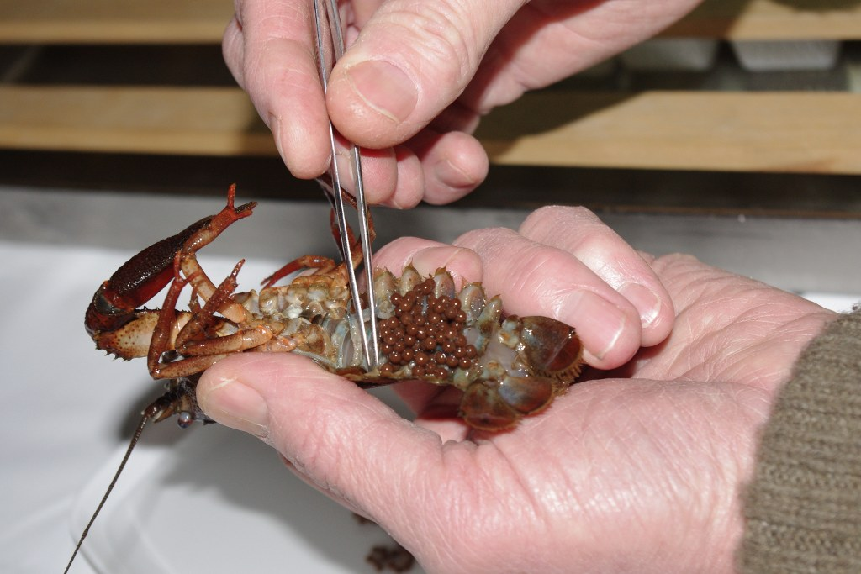
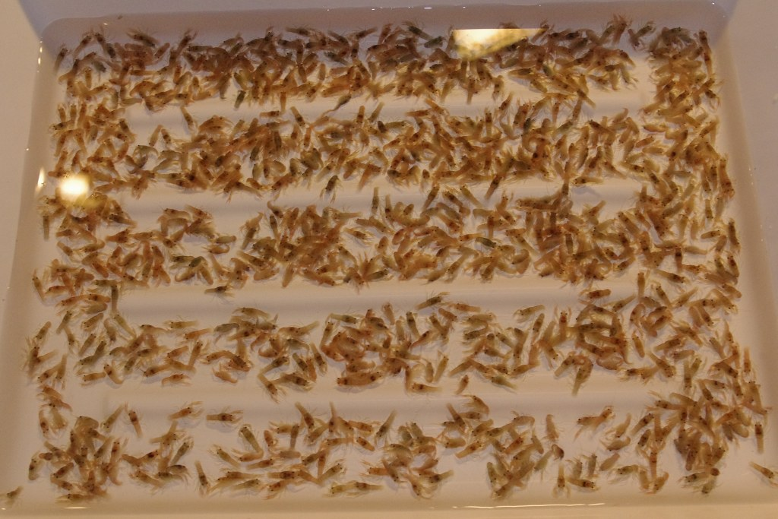
The Hemputin
Designed for Astacus astacus and Pacifastacus leniusculus with low water temperature, protracted incubation and small egg numbers
Developed by Teuvo Järvenpää and others in Finland
Modifications necessary for high water temperature, short incubation and large egg numbers
The Valverde incubator was launched in 2008
Notes:
Slide for body text

Slide 13
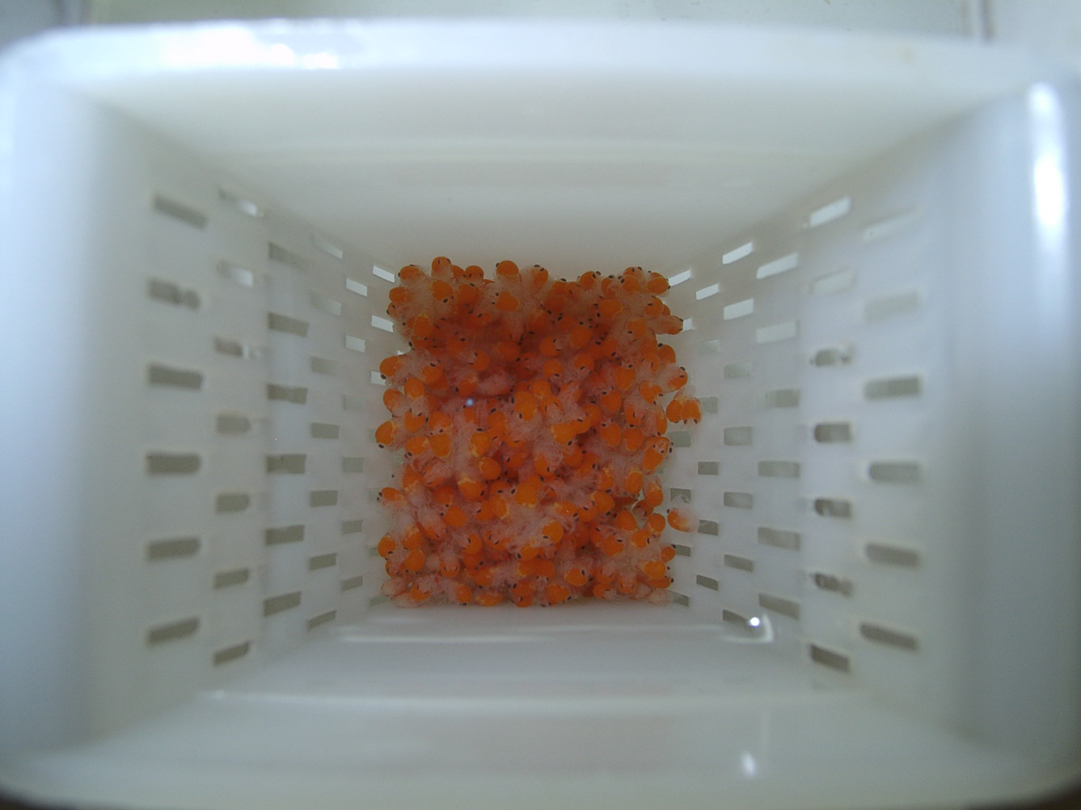
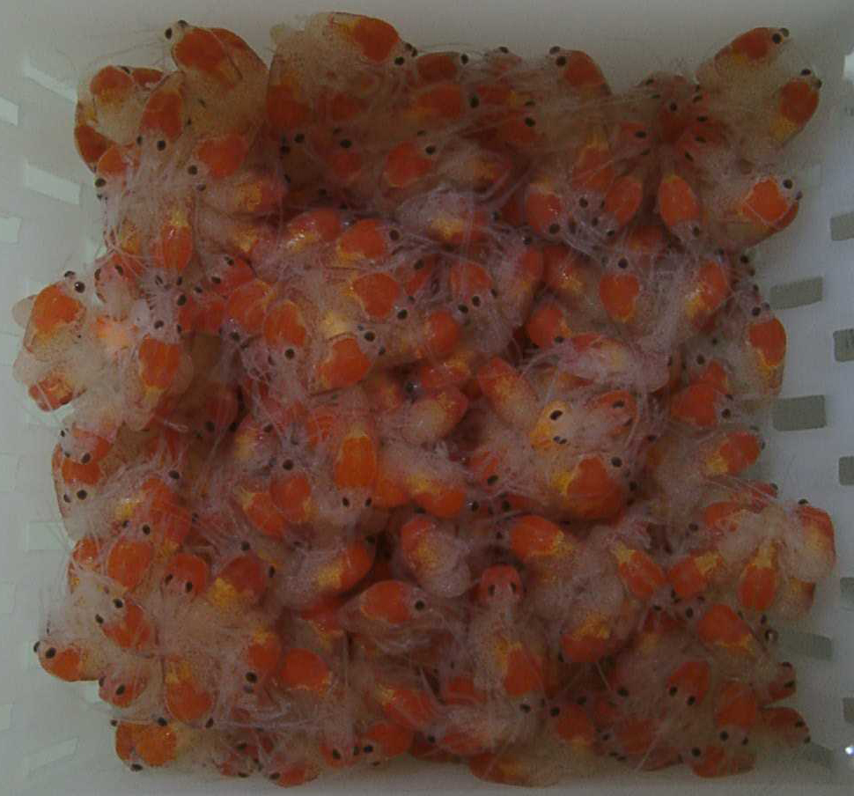
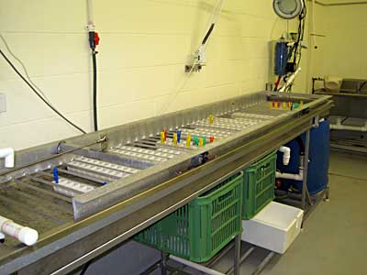
Hatchery
Notes:
Slide for body text

Slide 14
Valverde incubator
Stainless steel tank (0.6 x 3m x 15cm deep)
Recirculating water system with advanced biofiltration and water treatment
Agitator system to simulate pleopod waving
Custom designed plastic egg containers
Notes:
Slide for body text

Slide 15
Hatchery procedure
Broodstock stocked to tanks with summer photoperiod and temperature
Optimal nutrition / natural breeding
Berried females isolated
Eggs incubated on female for 2-3 weeks, then stripped at eyed stage
Then transferred to incubator
Notes:
Slide for body text

Slide 16
Hatchery productivity
500 to 1000 eggs per female
90+% hatch rate
One incubator can be stocked with 200,000 eggs
3-4 weeks incubation until hatch
Output of up to 180,000 craylings
Notes:
Slide for body text

Slide 17
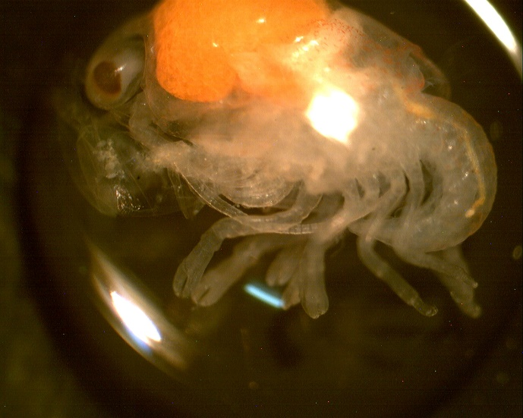
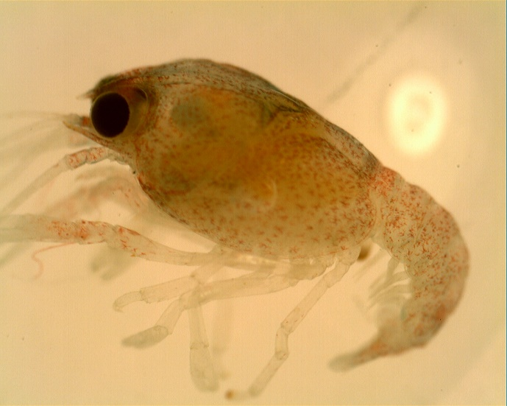
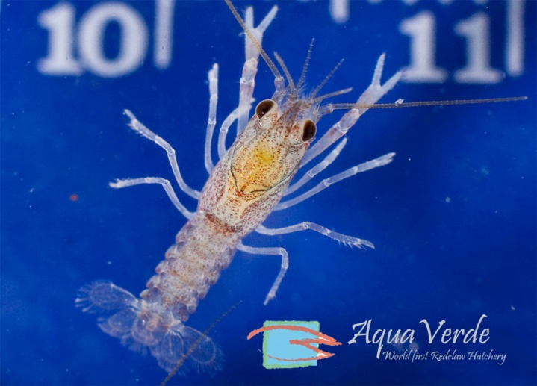
Craylings
Eggs hatch to first stage post-larvae, retained in the incubator
These moult to second stage – retained in incubator
After a second moult the third stage juvenile is fully independent and is then referred to as a crayling
Craylings removed from incubator for sale
Notes:
Slide for body text

Slide 18
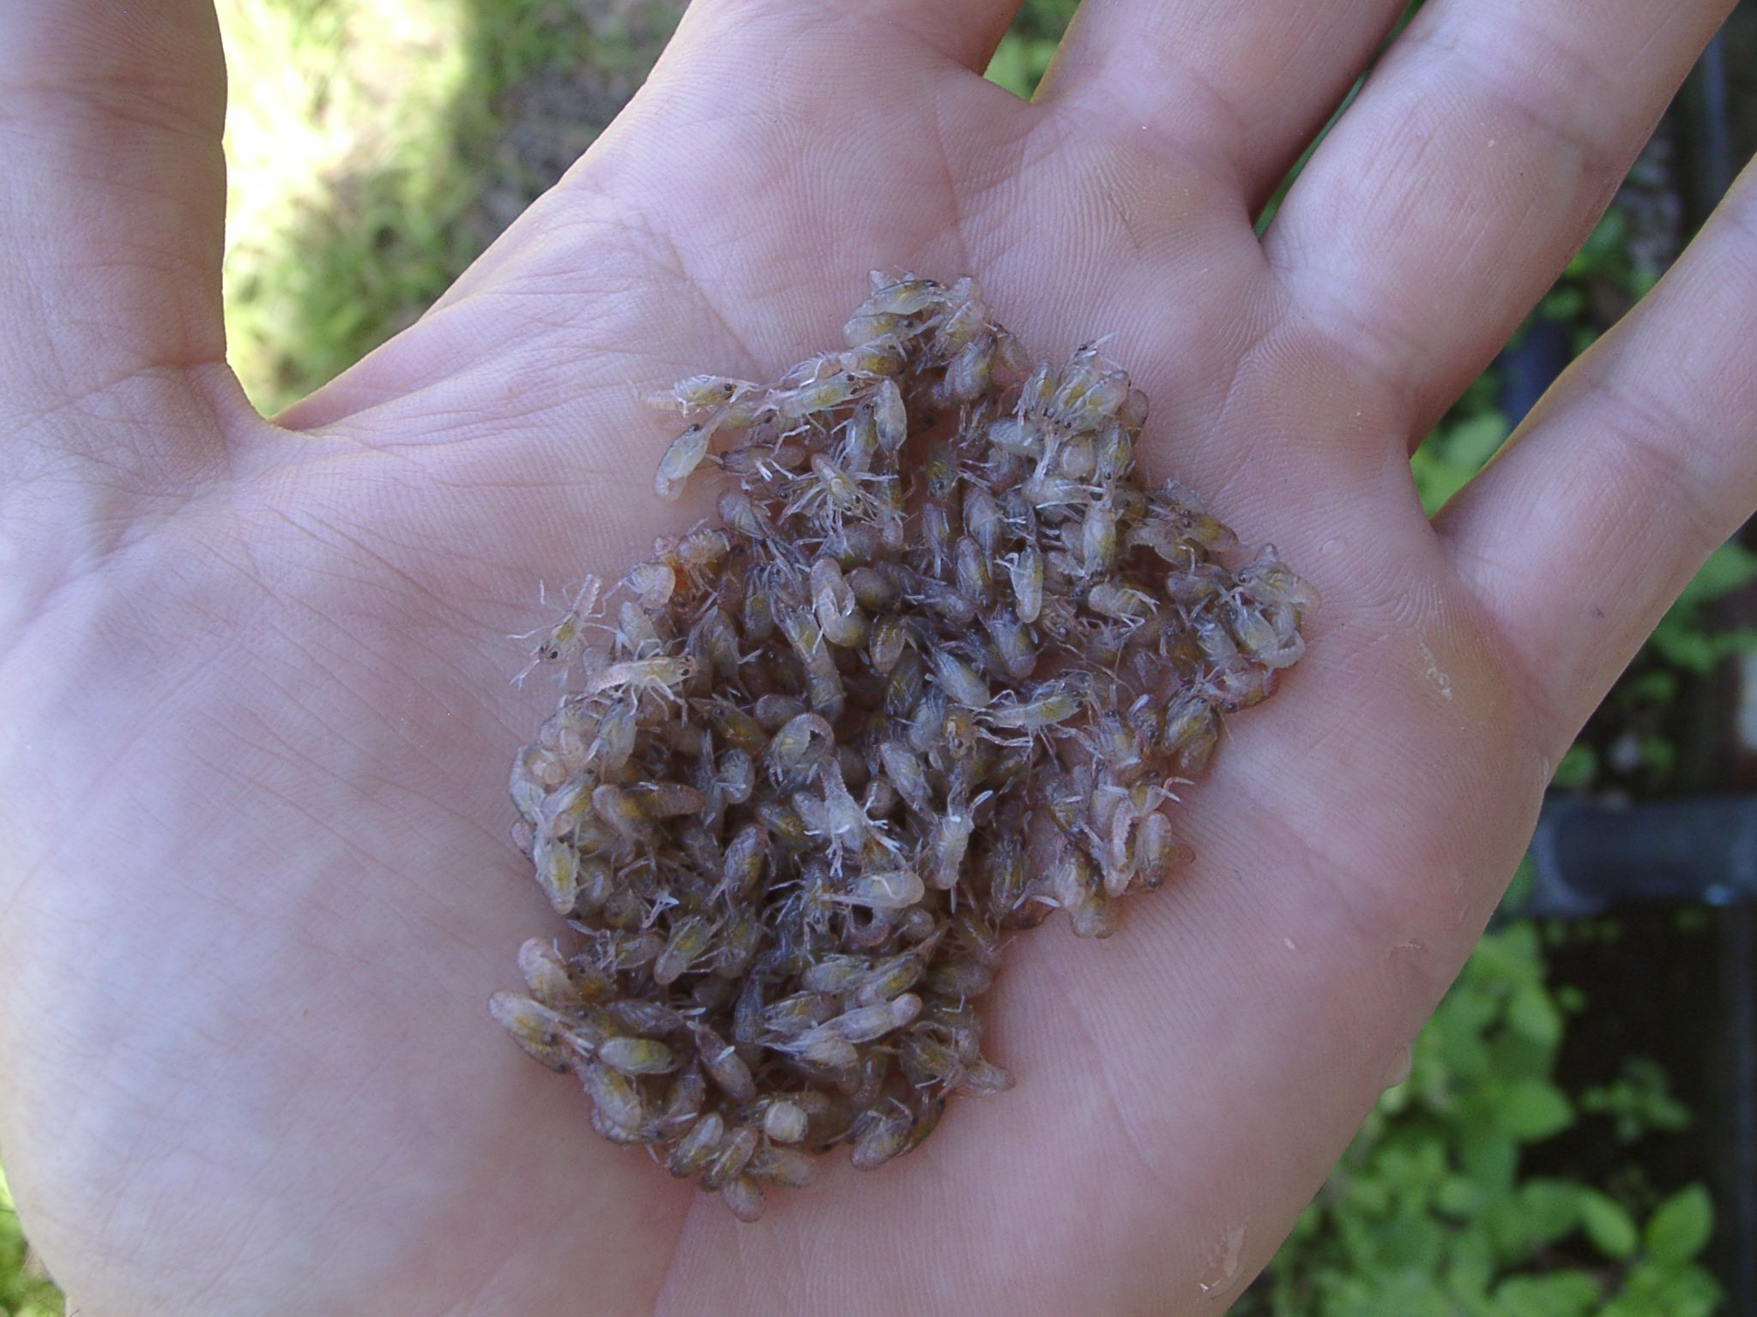
Crayling rigour & transport
Small (16mg) and delicate
Suitable for easy transport
2,000 craylings per L
Plastic bags, oxygen, cool temperature
Styrofoam box
Road or air transport over 24 to 48 hours
Notes:
Slide for body text

Slide 19
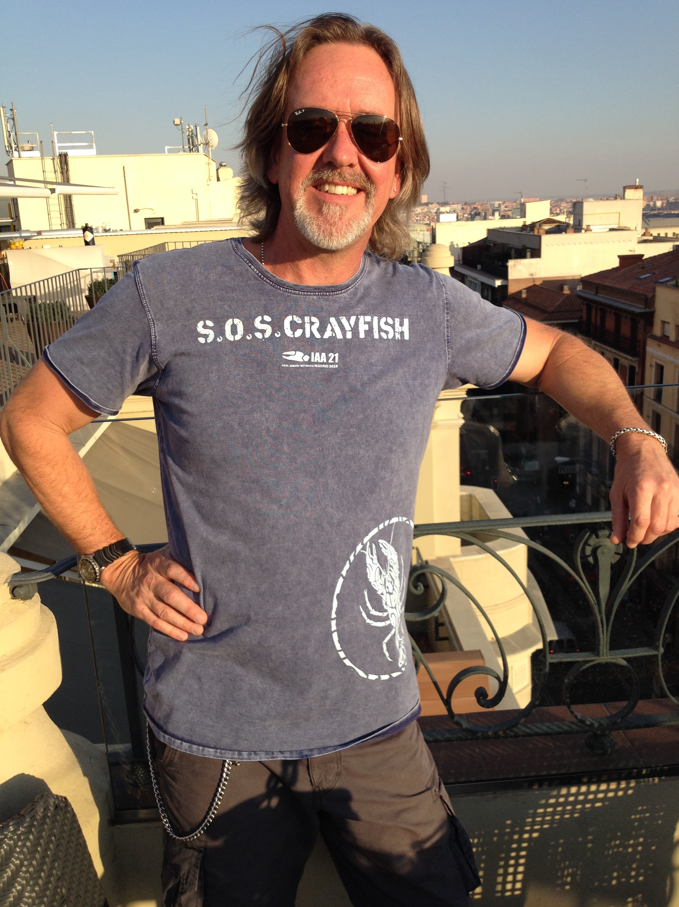
Crayling performance
Variable survival and production in earthen pond
Is a nursery phase required?
PhD research – Damian Rigg JCU
Notes:
Slide for body text

Slide 20
Further R&D - hatchery
Survival through incubation
Periodic bacterial induced mass mortality – Aeromonas hyrdophila
Development of Bacteriophage
System hygiene
Key - consistency
Notes:
Slide for body text

Slide 21
Further R&D - craylings
Survival over first 4 weeks
Nursery phase
Diet
Temperature
Density
Shelter
Damian Rigg PhD research
Notes:
Slide for body text

Slide 22
Commercial hatchery status
Aquaverde Hatchery (http://www.aquaverde.com.au)
1 to 2 million craylings per year from 2 incubators
Capacity for 5-10 million if bacteria-induced crashes could be eliminated
Year-round production through managed breeding
Notes:
Slide for body text

Slide 23
Status
Queensland redclaw industry ready to embrace hatchery generated craylings
Demand for 50 million per year
Foundation for significant industry expansion
Notes:
Slide for body text

Slide 24
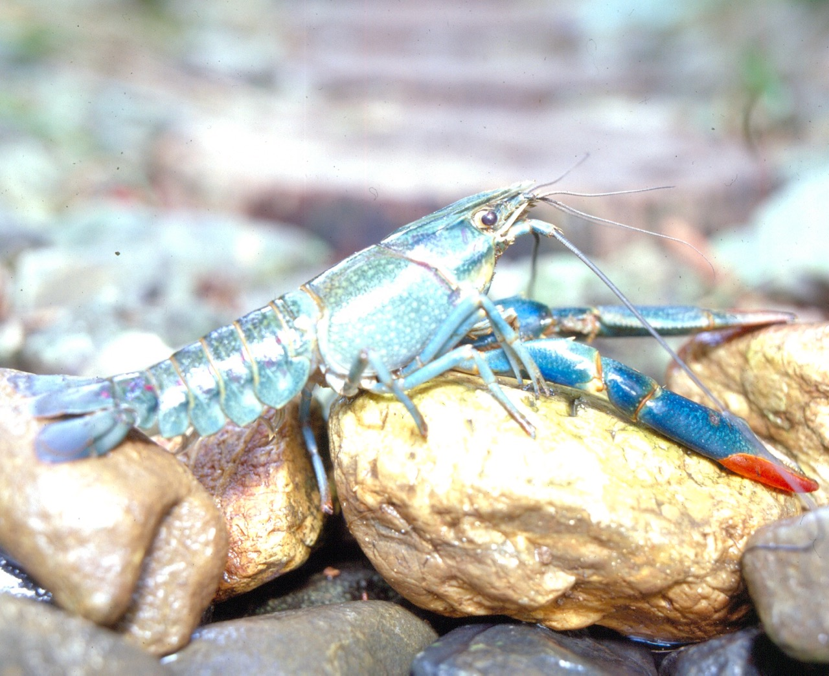
Thankyou
Notes:
Slide for body text

Slide 25
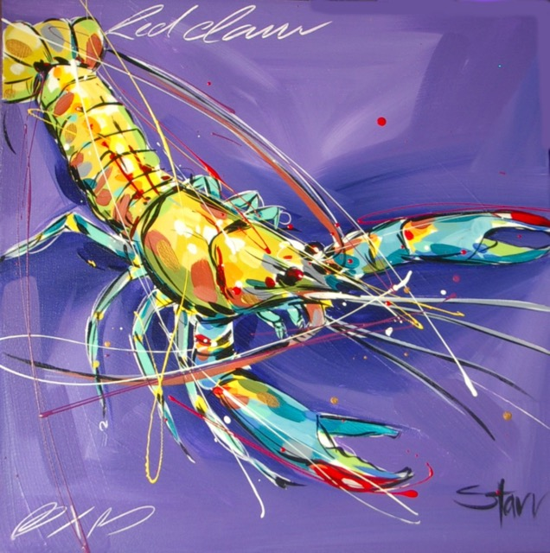
Notes:
Slide for body text

